Slide 1

Recommendation System
22.03.2024
21.03.2025

Slide 2
Agenda ↗
What is recommendation system
Content-based filtering
Neighborhood-based collaborative filtering
Evaluating recommender system
Notes:
Si consiglia l’uso dei rettangoli arrotondati, in combinazione con il Work Sans Medium, per mettere in evidenza punti salienti dell’agenda. Se non ve ne sono, eliminateli.
Per fare in modo che i numeri in elenco siano in IBM Plex Serif: Clicca su uno dei numeri in elenco (si evidenzieranno tutti) > assegna IBM Plex Serif Chiaro > Assegna il Verde scuro(#00a491) ai numeri con lo strumento Colore Testo

Slide 3
01.
01.
What is Recommendation System?
Notes:
Si consiglia l’utilizzo della copertina in blu solamente per slide destinate all’utilizzo online.

Slide 4
Recommender system
What is recommender system
A recommender system is an algorithm designed to suggest items, content, or actions to users based on various factors such as user preferences, behavior, and historical interactions. These systems analyze data to identify patterns and predict what users will find interesting or useful, aiming to enhance user experience by providing personalized recommendations.

Slide 5
01.
02.
Content-based filtering
Notes:
Si consiglia l’utilizzo della copertina in blu solamente per slide destinate all’utilizzo online.

Slide 6


Recommender system
Content-based filtering
A content-based recommendation system - is a recommendation system focusing on recommending items based on their attributes rather than user behavior data.
genres: [science fiction, romantic comedy, horror, western, …]
year: [1991, 1995, 2015, ... ]
the recommendation is made based on movie genres (ex: horror) and release years (1995)

Slide 7
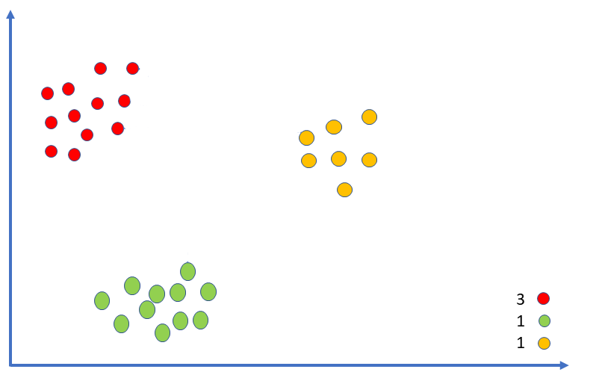
Recommender system
Content-based filtering
cluster: “horror”
apply k-nearest neighbors (KNN) algorithm to the items of database (films)
assign “score” to each cluster as a weighted average of the similarity scores and the user's ratings for these k items (films)
select top N items based on the score
cluster: “comedy”
films that user has already seen
user rating
cluster: “western”

Slide 8
Recommender system
Content-based filtering
ADVANTAGES
DISADVANTAGES
Personalized Recommendations: recommendations based on item attributes user has previously liked
No Cold Start Problem for Items: new items can be recommended as long as their attributes are known
User Independence: recommendations based on the user’s own preferences without relying on other users'
Transparency and Control: users can understand why certain items are recommended based on the attributes they prefer
Consistency: recommendations remain stable over time as they depend on item attributes, which don’t change
Limited Discovery: recommendations are too similar to what users have already seen
Feature Engineering: recommendations depend on the quality and completeness of item attributes
Cold Start Problem for Users: new users without a sufficient history of interactions don’t receive recommendations
Scalability: depends on number of items and attributes

Slide 9
01.
03.
Neighborhood-based filtering
Notes:
Si consiglia l’utilizzo della copertina in blu solamente per slide destinate all’utilizzo online.

Slide 10
Recommender system
Neighborhood-based collaborative filtering
User-based collaborative filtering
Item-based collaborative filtering

Slide 11

Recommender system
Neighborhood-based collaborative filtering
User-based collaborative filtering
User-based collaborative filtering involves recommending items to a user by finding other users with similar rating histories and suggesting items they liked but the target user hasn’t seen.
user_1: {film_1: 5, film_2: 4…}
user_2: {film_2: 2, film_6: 5…}
….
the recommendation is made based on preferences of other users (ex: users that watching Marvel movies)

Slide 12

Recommender system
Neighborhood-based collaborative filtering
User-based collaborative filtering
Create a table of all ratings from all users
Compute similarity scores between users based on their rating histories
For a given user, identify the top similar users from the precomputed similarity matrix.
Filter out items the user has already rated (or watched liked films) and proposed new ones
 | 4 | 5 | - | -
 | 4 | ? | - | 2
 | - | - | 4 | 5

Slide 13
Recommender system
Neighborhood-based collaborative filtering
Item-based collaborative filtering
Item-based collaborative filtering involves recommending items to a user by finding other items similar to those the user has already liked.
item_1: 5
item_2: 4
….
the recommendation is made based on preferences of the user and similarities with items that he likes

Slide 14
Recommender system
Neighborhood-based collaborative filtering
Item-based collaborative filtering
 | 4 | 5 | - | -
 | 4 | 5 | - | -
 | 1 | 2 | 5 | 4
 | 1 | 1 | 5 | 5
Create a table of all item positive ratings
Compute similarity scores between items based
For a given item, identify the top similar items from the precomputed similarity matrix.
Filter out items the user has already rated (or watched liked films) and proposed new ones from the same “cluster”

Slide 15
Recommender system
Neighborhood-based collaborative filtering
ADVANTAGES
DISADVANTAGES
No Need for Domain Knowledge: not require domain-specific information about the items
Novelty: introduce users to unexpected items that are popular among similar users.
Scalability: low performance with large datasets due to the need to compute similarities between many users or items.
High Memory Usage: Storing large similarity matrices can be resource-intensive.
Cold Start for Users: Difficult to provide accurate recommendations for new users with little or no rating history.
Popularity Bias: Tends to recommend items that are already popular, potentially ignoring niche items.
Dependence on Historical Data: Can only recommend items that have been rated in the past, not new or unrated items.

Slide 16
01.
04.
Evaluation
Notes:
Si consiglia l’utilizzo della copertina in blu solamente per slide destinate all’utilizzo online.

Slide 17
Evaluating recommender system
Accuracy Metrics (RMSE and MAE)
Historical Context: The focus on RMSE in recommender systems research originated from the Netflix Prize (2006-2009), which offered a million-dollar reward for improving Netflix's RMSE by 10%. This spurred significant research into accuracy metrics.
Reality: RMSE (root mean square error) and MAE (mean absolute error) provide a way to measure prediction accuracy offline to predict a rating of item that a user may give, but they don't capture user satisfaction with recommendations.

Slide 18
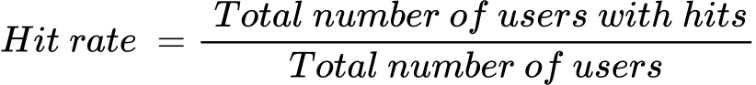
Evaluating recommender system
Top N hit rate
train the model on train set
generate top N recommendation for test set
if one of recommendation of top N is something that the user actually rated -> HIT (it means that user found this item “interesting” to him)
calculate hit rate to evaluate the system's ability to include at least one relevant item in the top recommendations for each user.

Slide 19
Evaluating recommender system
Coverage, diversity and novelty
Coverage: the percentage of possible recommendations that the system can provide. It reflects how well the system can recommend a wide range of items. High accuracy might reduce coverage. Coverage is crucial for the inclusion of new items in recommendations, which initially lack data and hence affect the coverage metric.
Diversity: the variety of items recommended. A system with low diversity might only suggest similar items (e.g., the next book in a series), while high diversity might suggest a broad range of items. However, too much diversity can lead to irrelevant recommendations.
Novelty: how new or unknown the recommended items are to the user. Novelty is about finding a balance between recommending popular, familiar items and new, lesser-known items, to ensure user engagement and satisfaction.

Slide 20
Material to further explore
Oreilly books and videos link
ML Mastery blog link
Udemy courses link
Coursera courses link (Stanford / DeepLearning.AI)
EdX courses link (HarvardX: CS50's Introduction to Computer Science)
Udacity courses link
Pycon Italia link
MIT open courses link

Slide 21





Kristina Khvatova
kristina.khvatova@vedrai.com
vedrai.com

